Slide 1
Computer Science Education
Dawn Guest-Johnson
Computer Science Coordinator
January 25, 2018

Slide 2
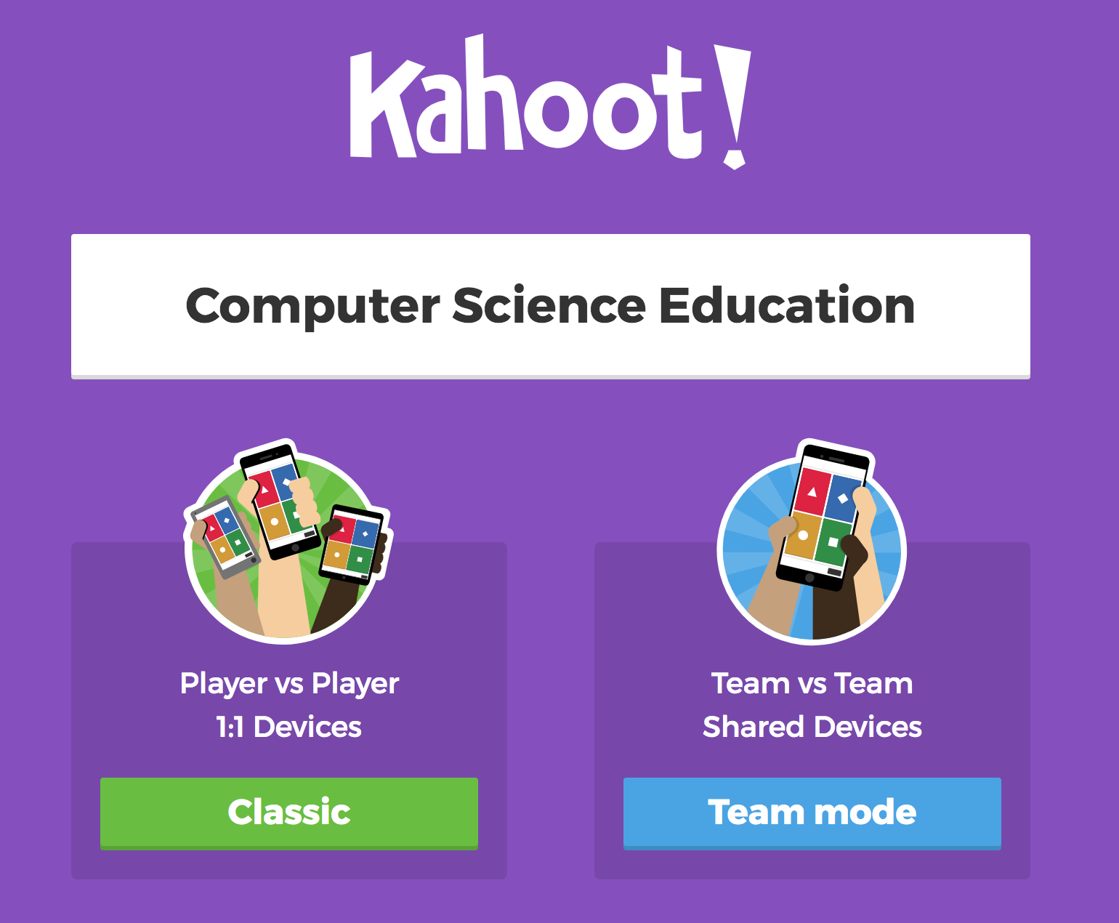
https://kahoot.it/

Slide 3
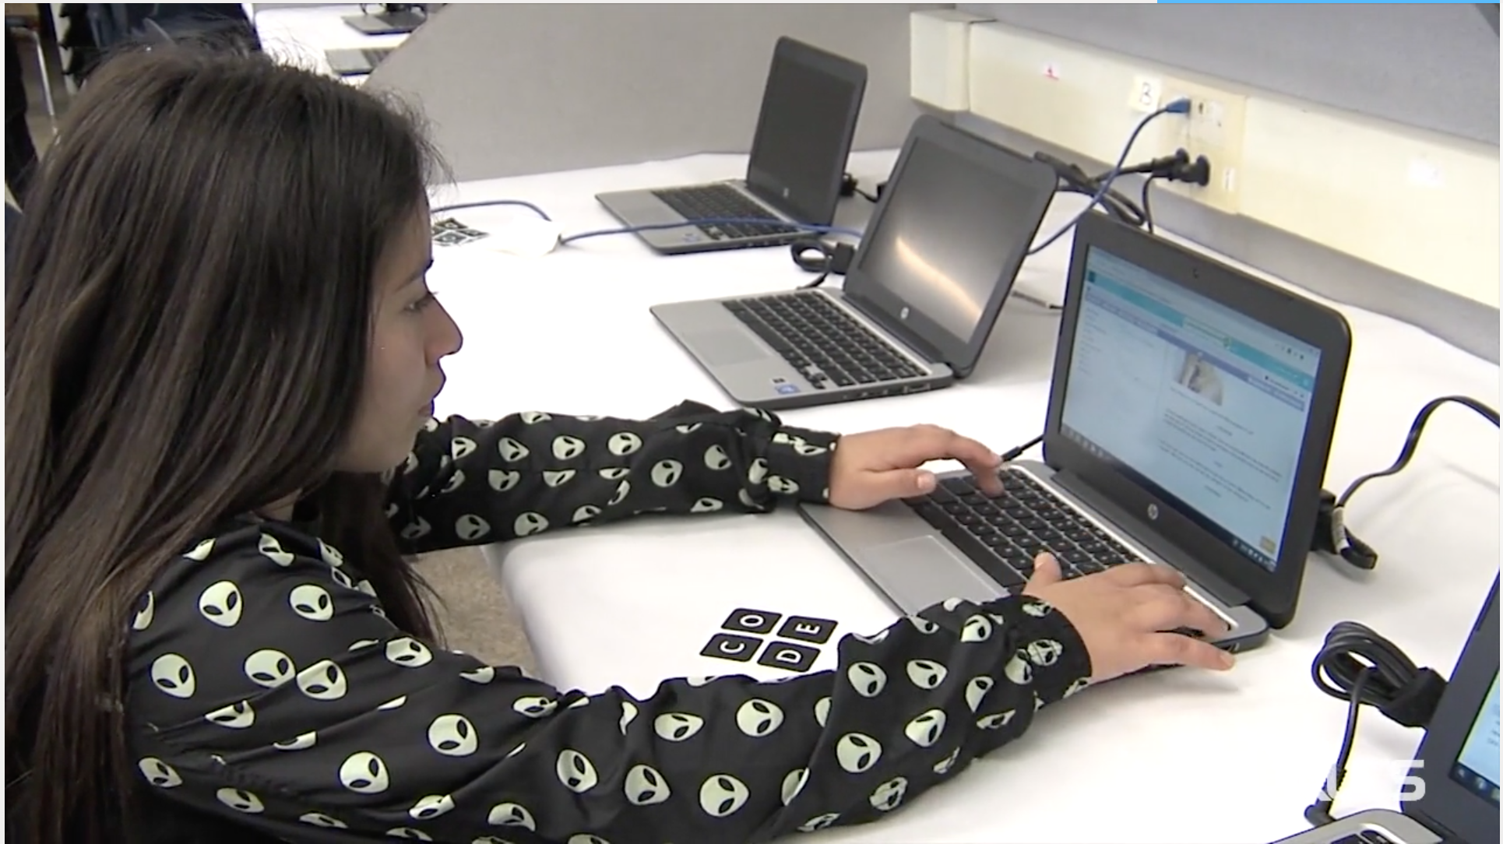

Slide 4
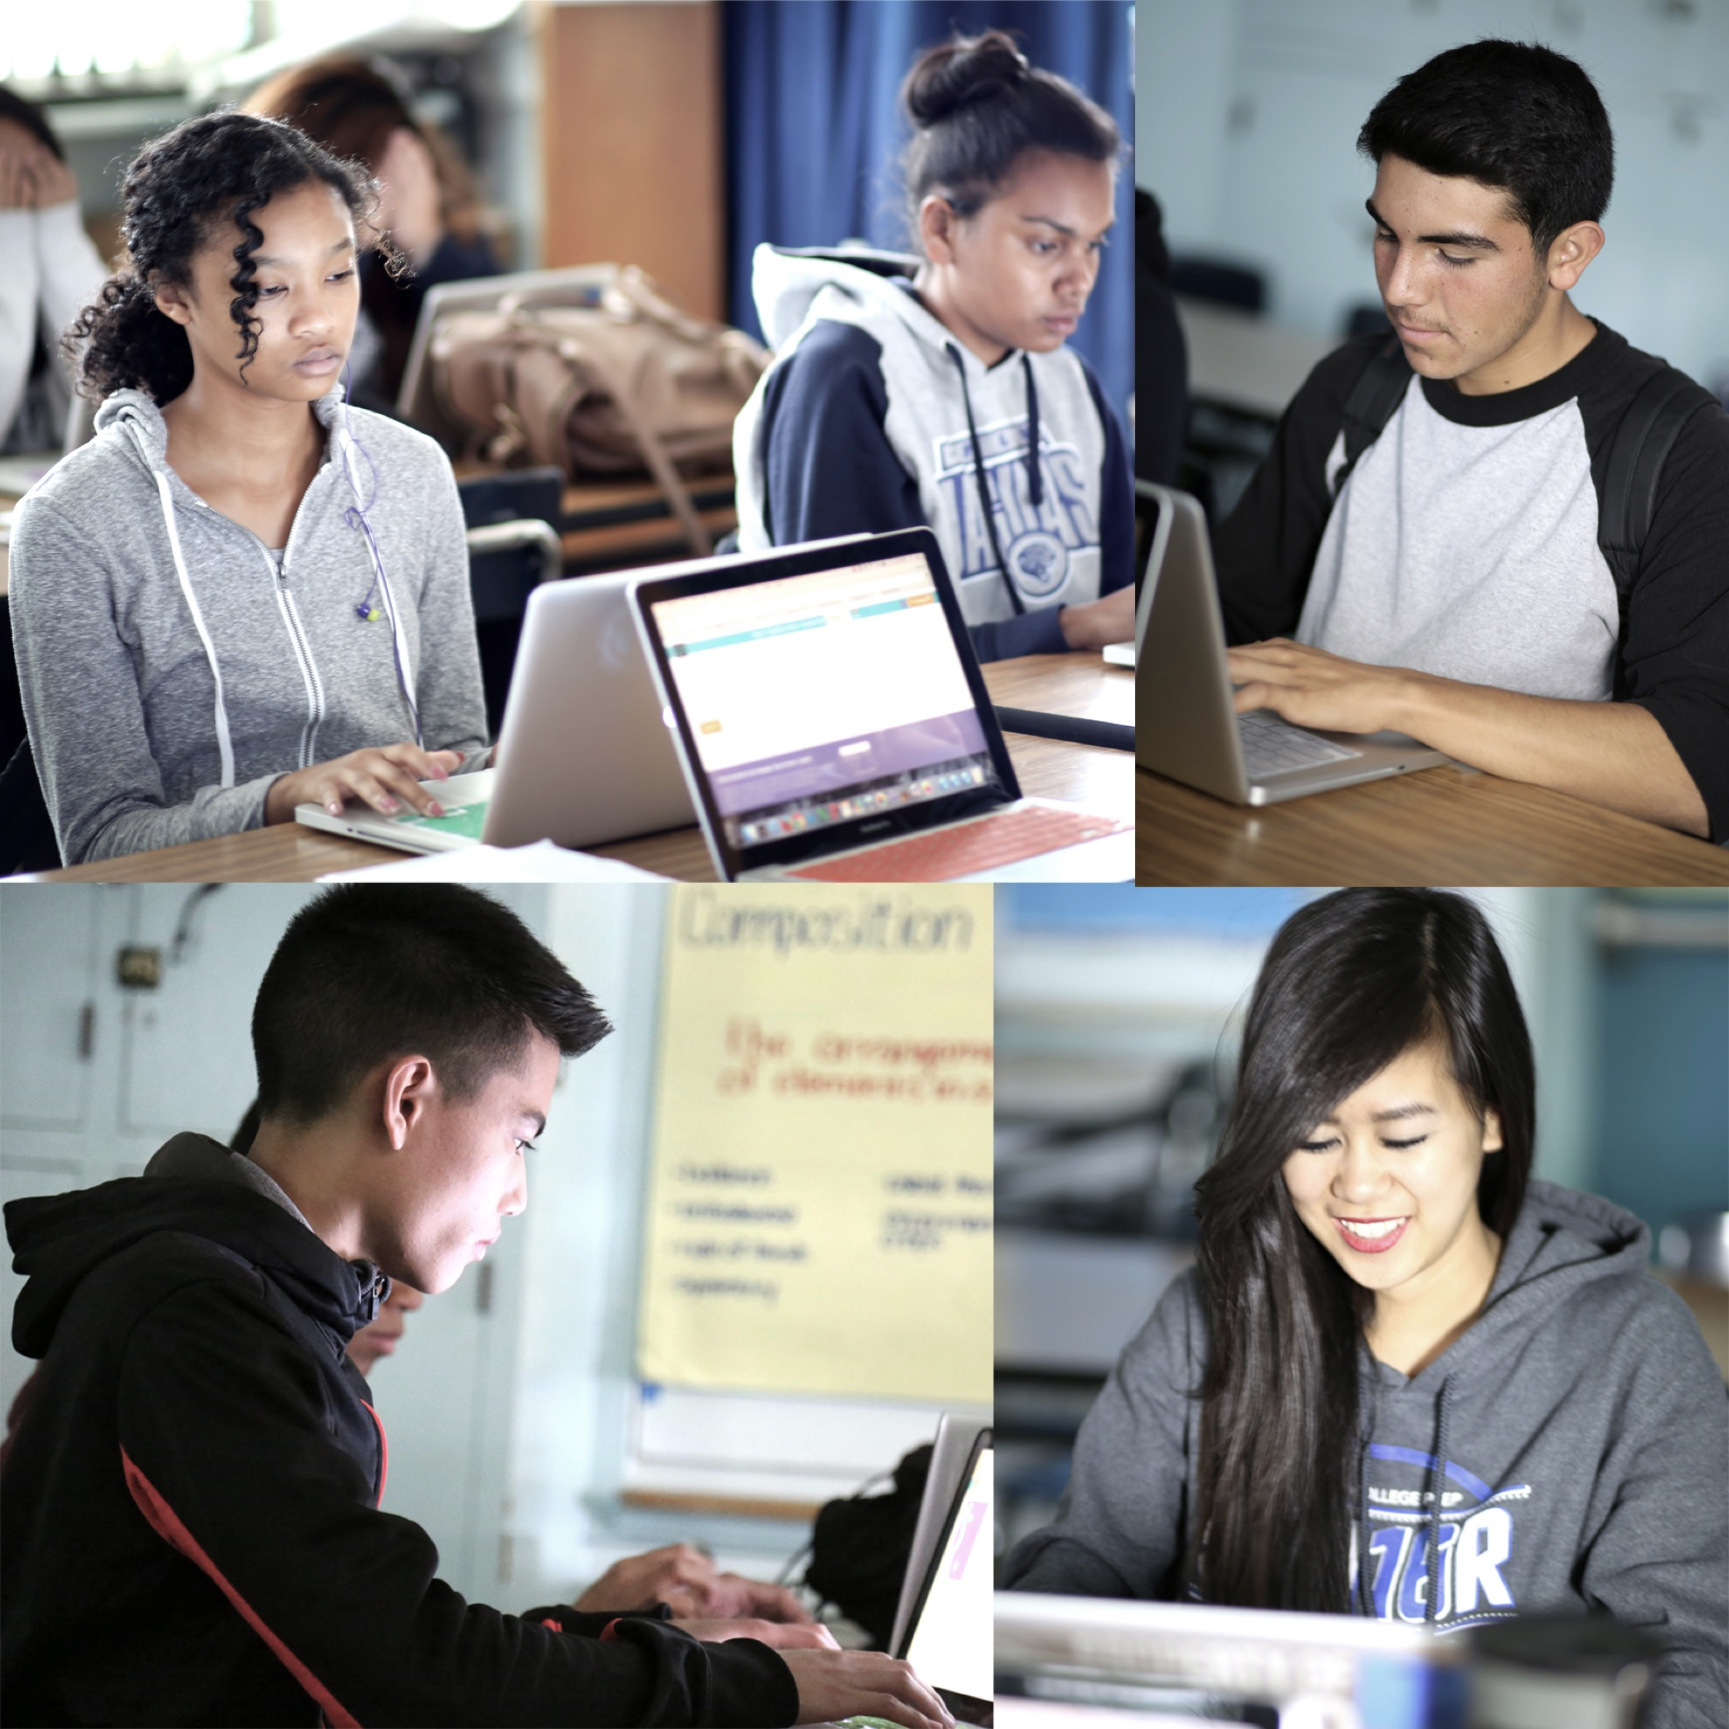
Computer Science invites learners to:
Be creators, innovators, and problem solvers
Understand the HOW and WHY of
computing systems
the network and internet
data and analysis
algorithms and programming
and the impacts of computing

Slide 5
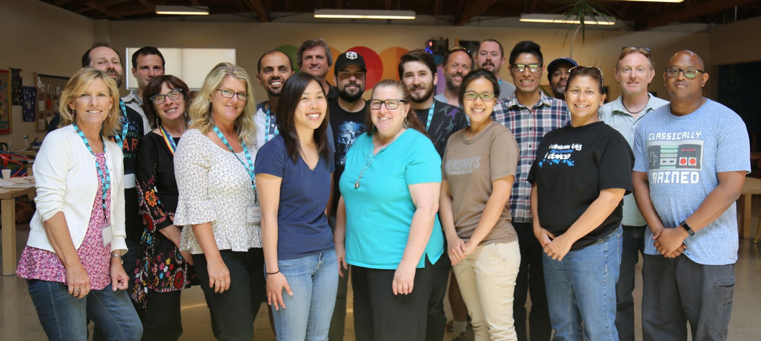
LAUSD and Computer Science
Current Computer Science Course Offerings:
Computer Science Fundamentals (Elementary)
Computer Science Discoveries (Middle School)
Exploring Computer Science (High School)
AP Computer Science Principles (High School)
AP Computer Science A (High School)
Career Technical Education Information and Communication Technologies Computer Science Courses (Middle and High School)
K-12 Computer Science Framework & Computer Science Teachers Association Standards for Students
Computer Science Education Week

Slide 6
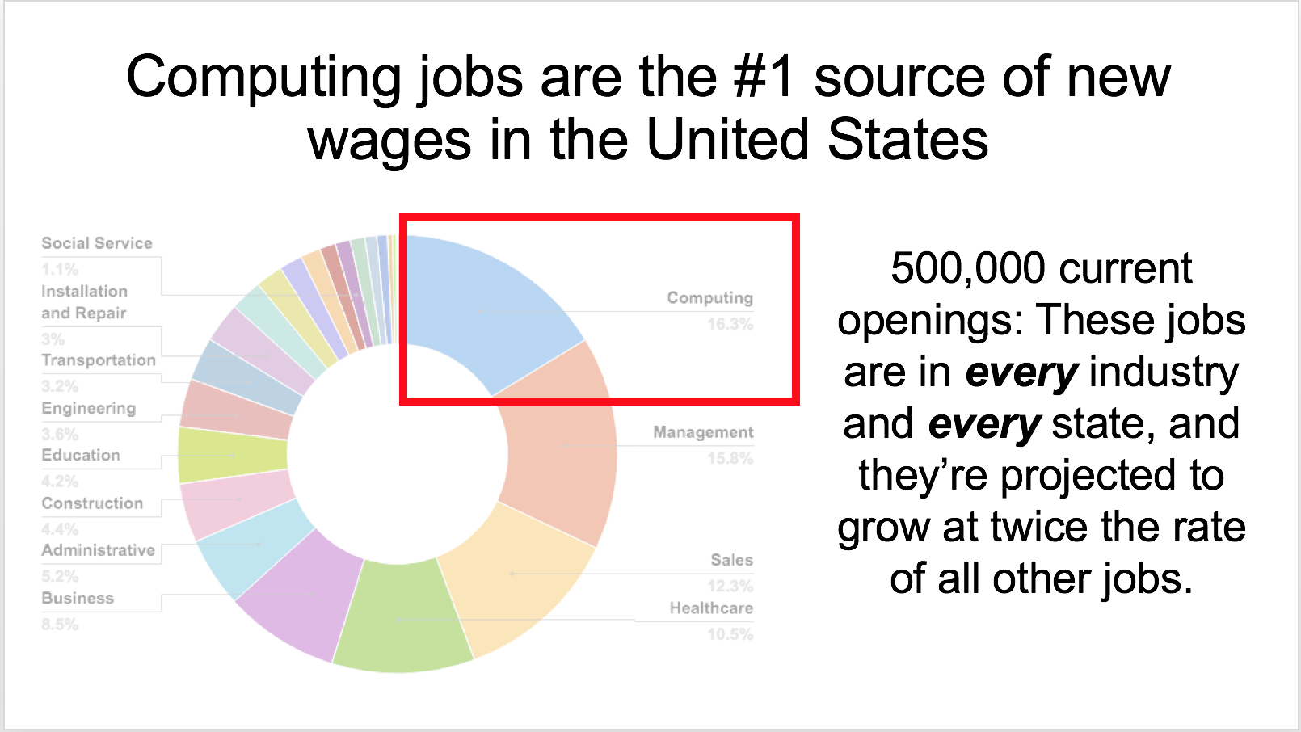

Slide 7
Vision for Computer Science Education
The District is committed to providing computer science education for all students by 2025, ensuring every student:
Receives 20 hours of computer science instruction each year in Pre-K – 5th grades.
Completes at least one rigorous and relevant computer science course in grades 6-8.
Has access to a computer science pathway in grades 9 through 12.

Slide 8
Give one, Get one

Slide 9
Thank You
Contact
Dawn Guest-Johnson
Computer Science Coordinator
dmg0923@lausd.net

